Slide 1
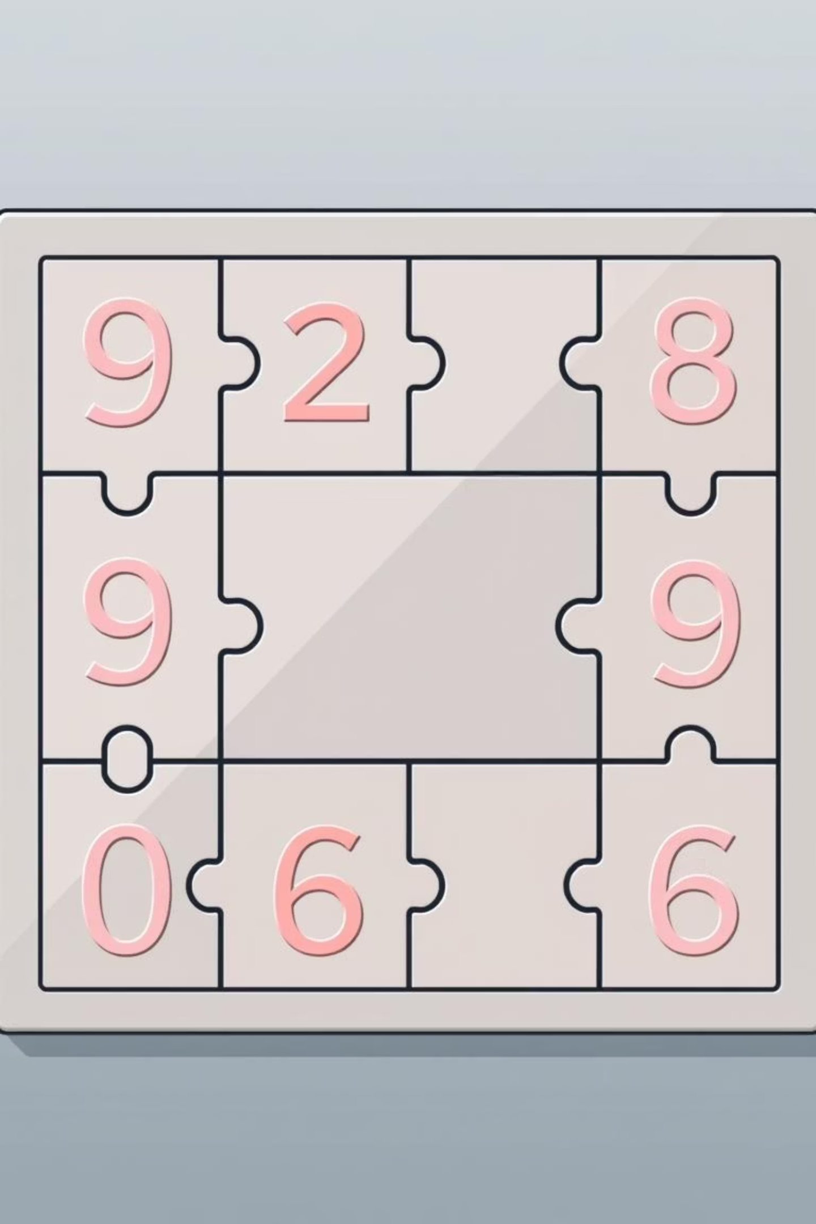
8-Puzzle Problem
Supervised by: Eng. Omar Khaled

Slide 2
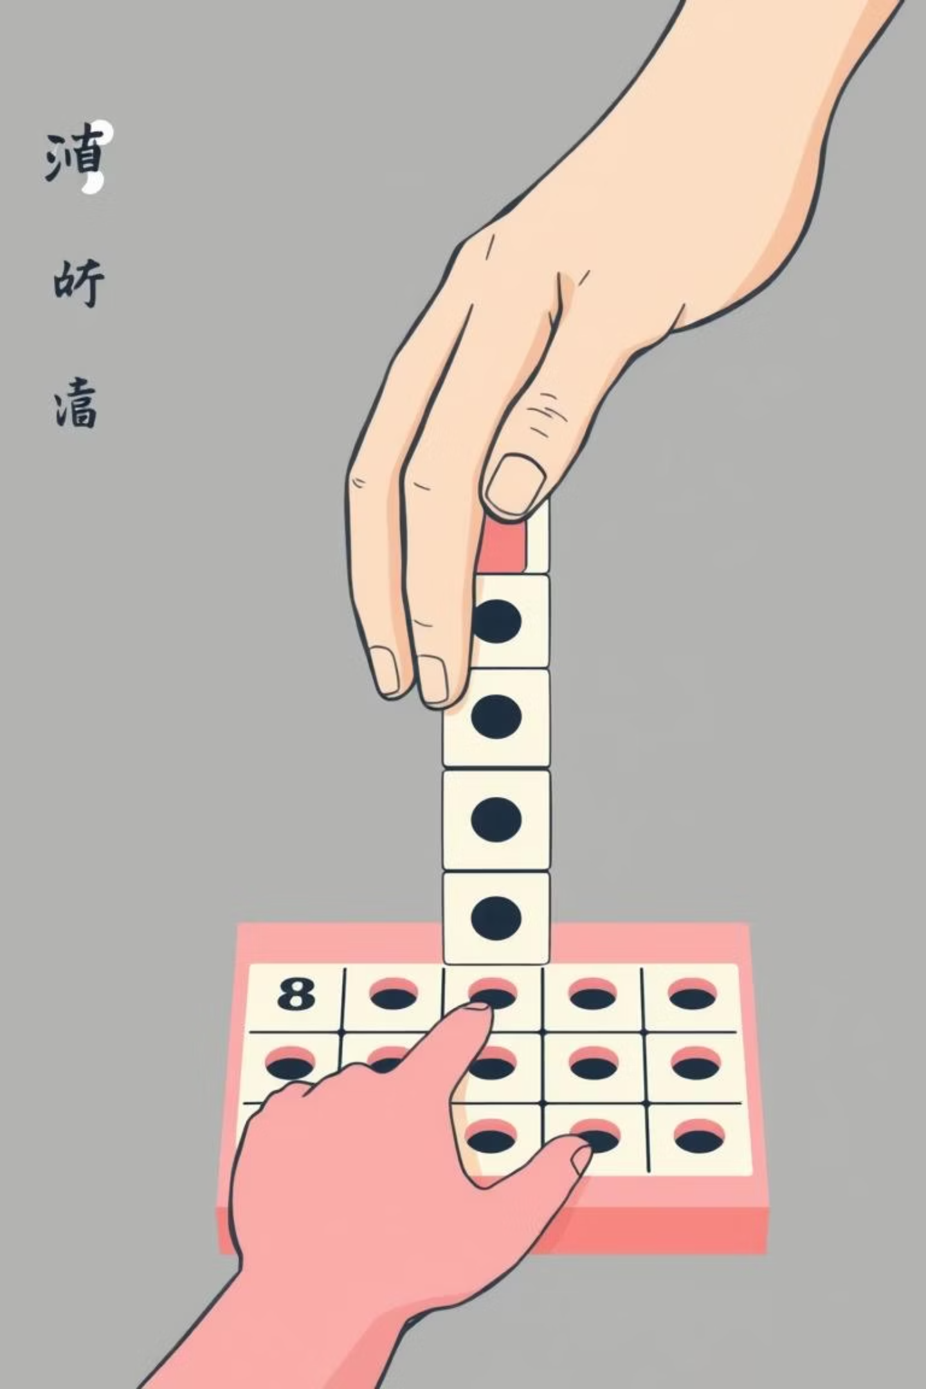
Understanding the 8-Puzzle
The Game Board
The 8-Puzzle is a famous game played on a 3x3 small board.
It features 8 numbered tiles (from 1 to 8) and one empty space.
The Challenge
Tiles begin in a random, messy order (the Start State).
The goal is to slide the tiles to reach a specific, correct numerical order.

Slide 3
Algorithms Explored for the 8-Puzzle
Breadth-First Search (BFS)
1
Depth-First Search (DFS)
2
Iterative Deepening Search (IDS)
3
A* Search (A-Star)
4
Hill Climbing
5

Slide 4
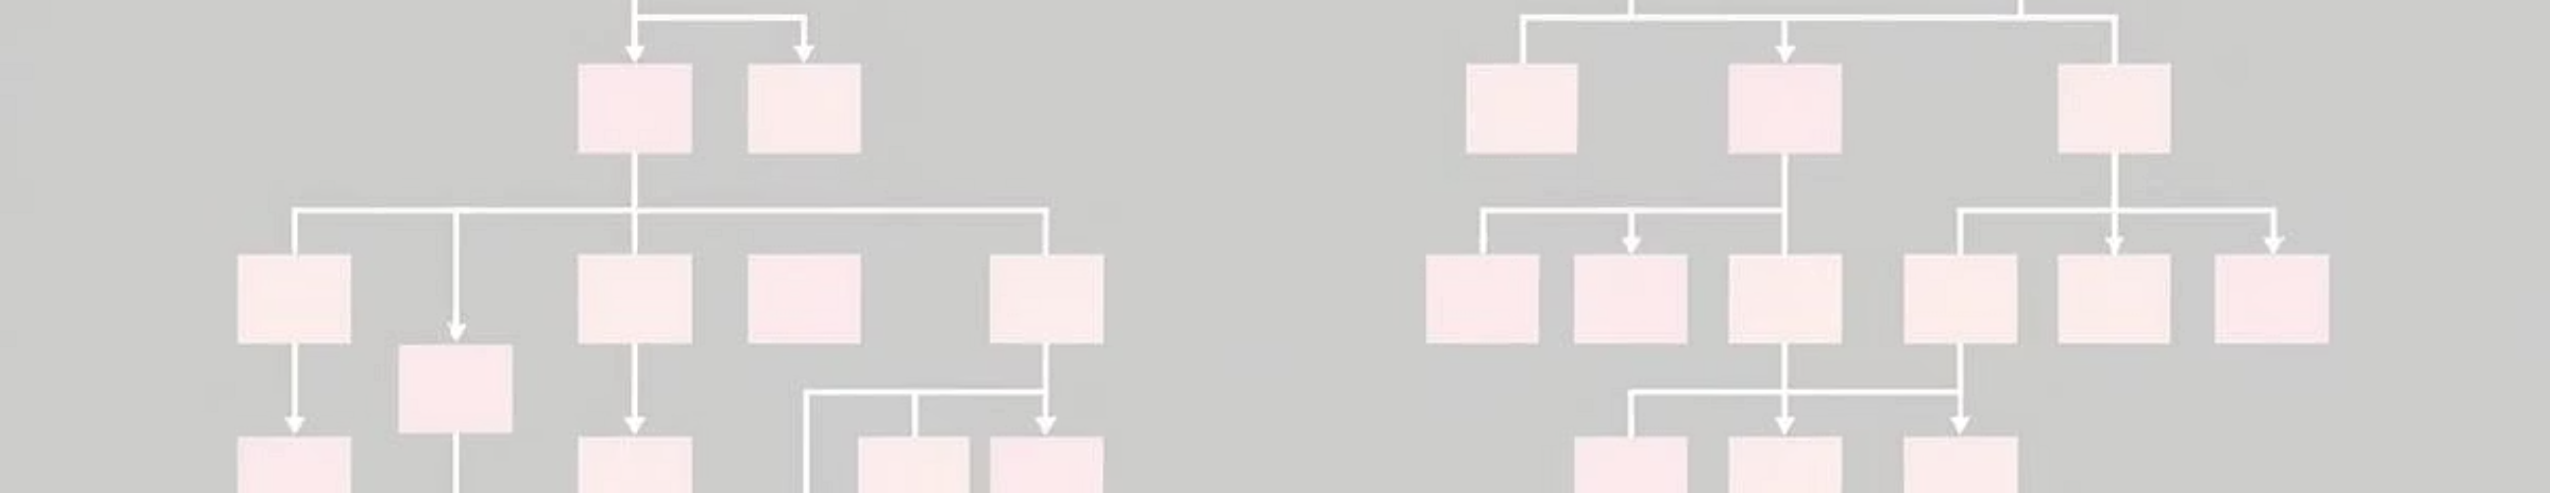
Breadth-First Search (BFS)
Systematic Exploration: Checks all possible moves step-by-step.
Level by Level: Searches through the problem space level by level, ensuring all shallow nodes are explored before deeper ones.
Optimal Path Guarantee: Always finds the shortest path or solution if one exists.
Resource Intensive: Can be slow and uses a lot of memory, especially for large problem spaces.

Slide 5
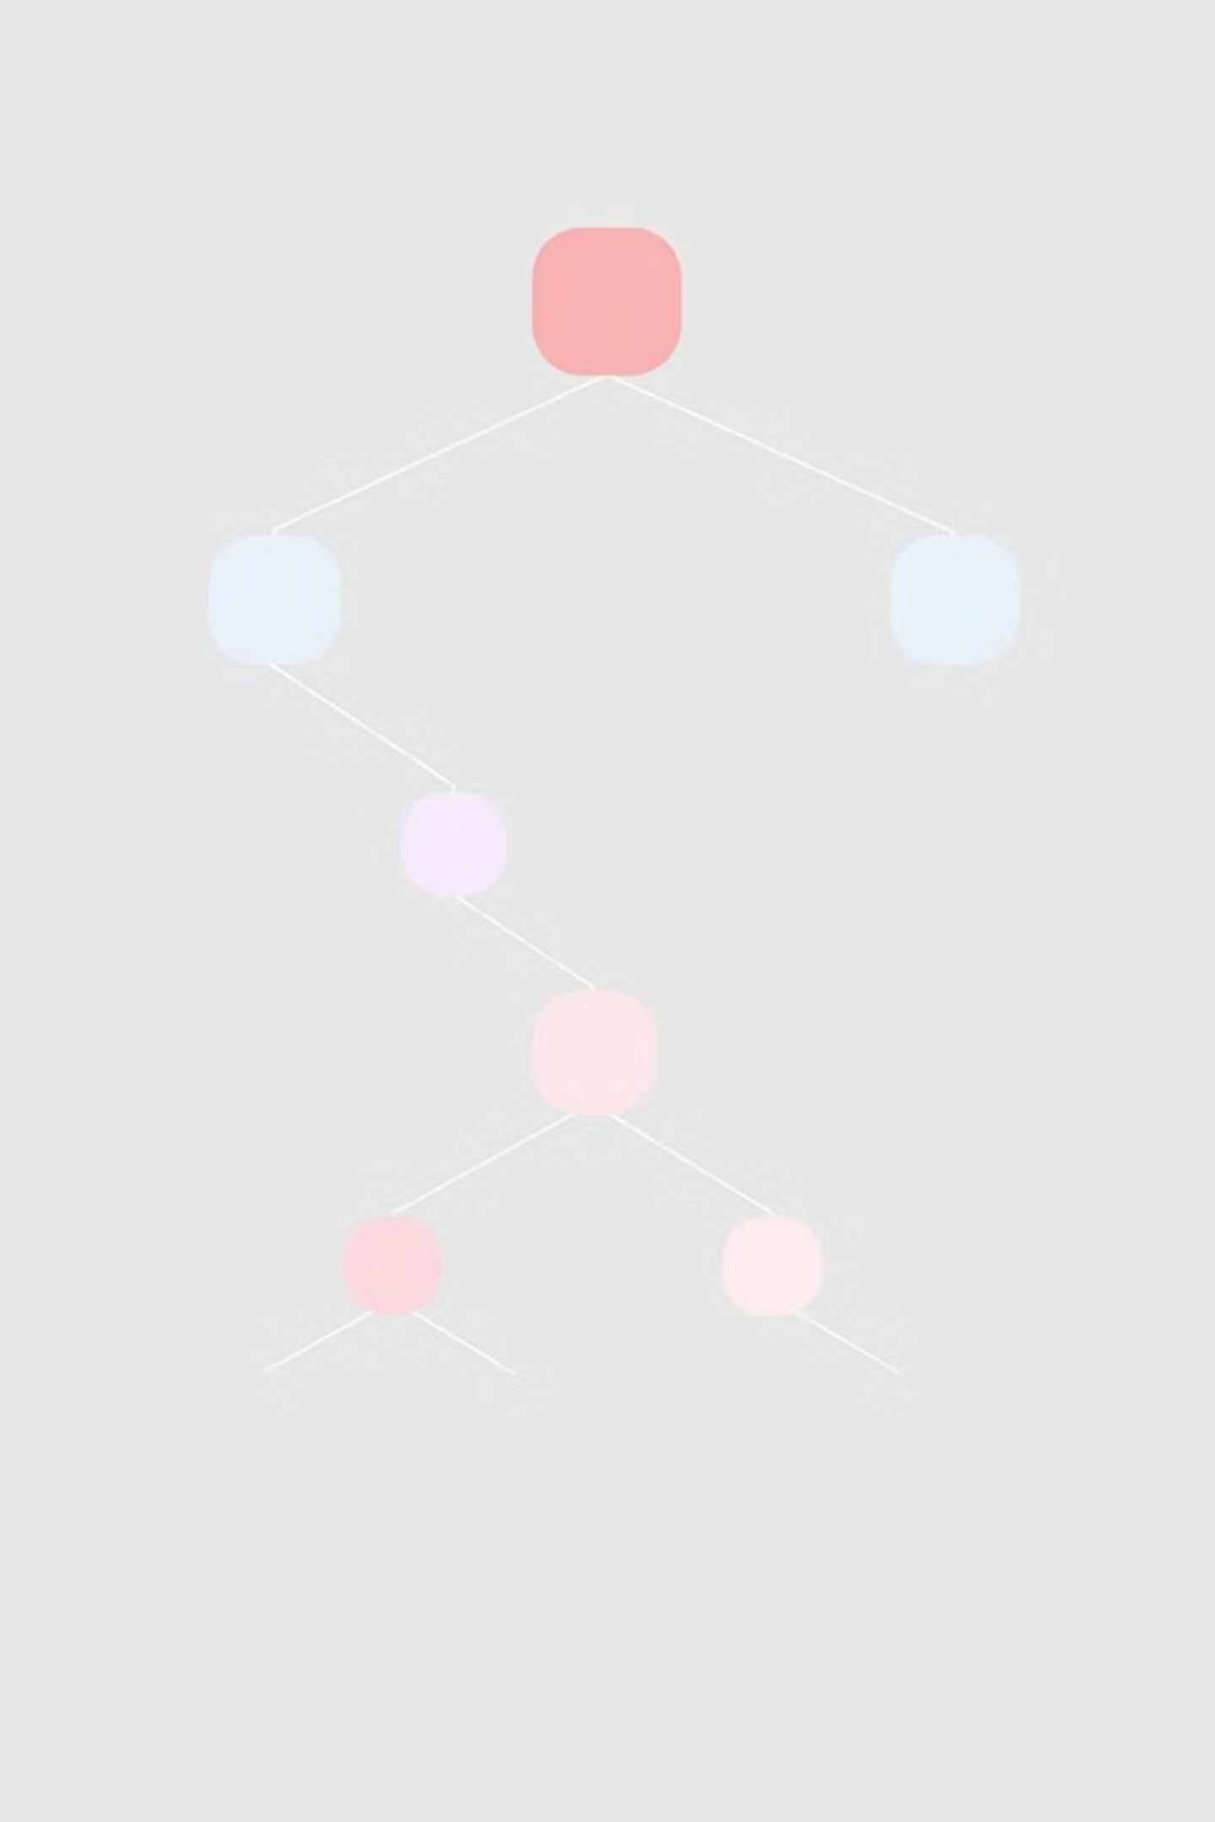
Depth-First Search (DFS)
Focused Exploration: Picks one path and goes very deep before backtracking.
Execution Speed: Generally fast in execution, as it avoids wide exploration.
Solution Length: Usually provides a very long solution path when a shortest path is not the priority.
Suitability for 8-Puzzle: Not ideal for the 8-Puzzle problem due to its tendency to find non-optimal, lengthy solutions.

Slide 6


Iterative Deepening Search (IDS)
Memory Efficiency
Progressive Depth
Uses significantly less memory compared to a pure BFS approach.
Hybrid Approach
Performs searches step by step, gradually increasing the depth limit with each iteration.
Combines the advantages of both Breadth-First Search (BFS) and Depth-First Search (DFS).

Slide 7





A* Search: The Smartest Algorithm
Intelligent Approach
Considered the smartest algorithm due to its informed search strategy.
Heuristic Function
Utilizes a heuristic function to estimate the cost from the current state to the goal state.
Optimal Choices
Chooses the best move based on calculated costs, ensuring efficient progression.
Fast & Optimal
Finds the optimal solution very quickly, making it highly efficient for the 8-Puzzle.

Slide 8



Hill Climbing: A Greedy Approach
Local Search
Quick Decisions
Examines only the immediate neighboring states to determine the next best step.
Chooses the most promising immediate neighbor, leading to very fast execution.
Potential Pitfalls
Can get stuck in local optima, failing to reach the global optimum or the ultimate goal.

Slide 9
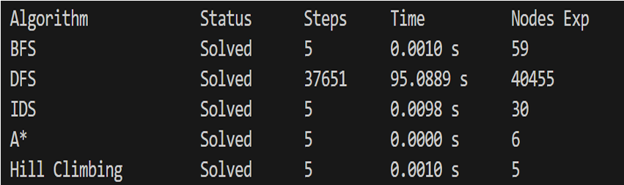
. Best Solution Optimality : A*, BFS, IDS, and Hill Climbing are excellent. They all solved the game in just 5 steps. DFS was very bad. It took 37,651 steps to solve the same simple game.
. Speed & Intelligence: Hill Climbing and A* are the winners here. Hill Climbing checked only 5 nodes The smartest .
A* checked only 6 nodes Very smart .
IDS checked 30 nodes. BFS checked 59 nodes. DFS wasted resources and checked over 40,000 nodes.
. Final: A* and Hill Climbing are the best algorithms for this
project because they are extremely fast and find the shortest way instantly.

